Slide 1
Comparison of Performance of Major stocks over past decade Meta (formerly Facebook), Amazon, Apple, Netflix, Google, Microsoft

Slide 2
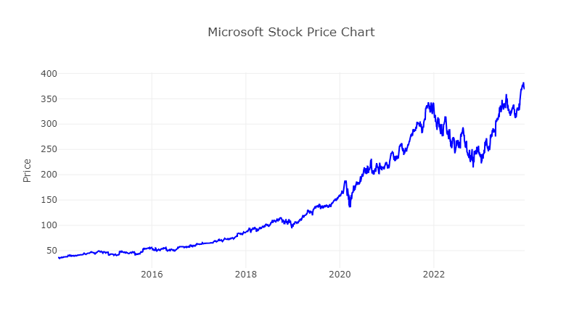
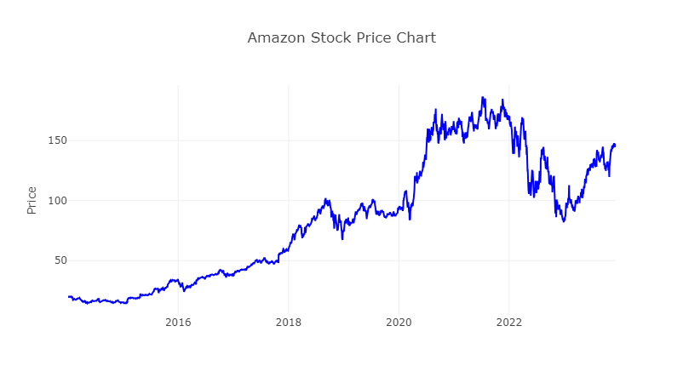
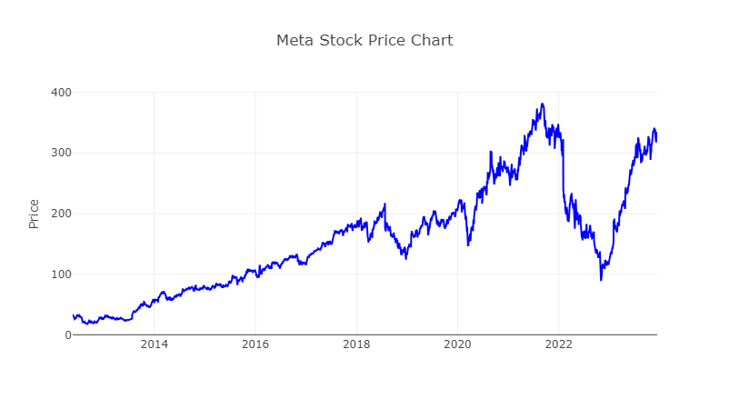
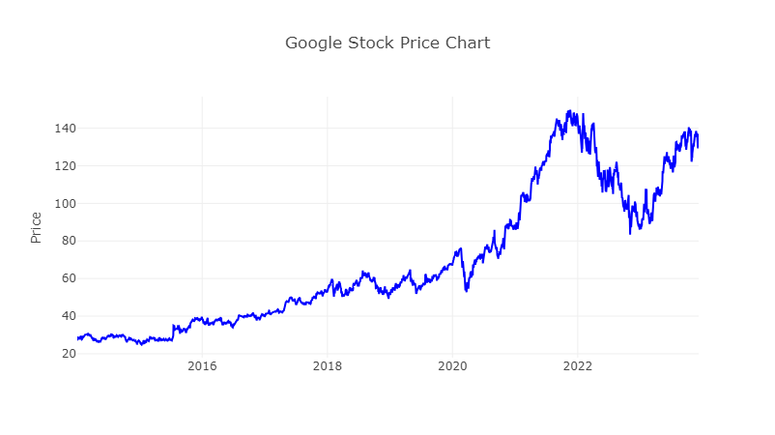

Slide 3
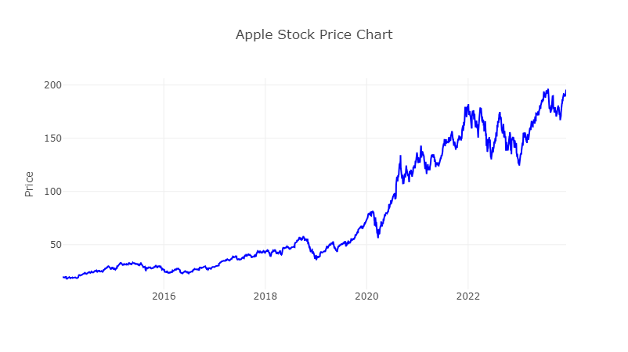
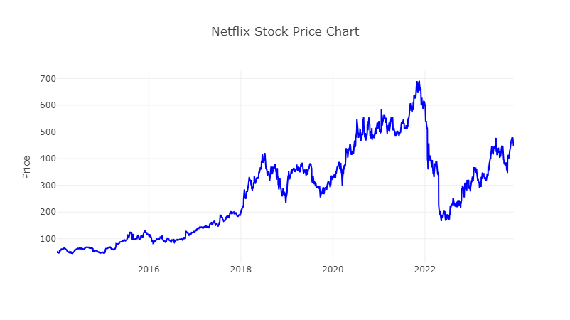
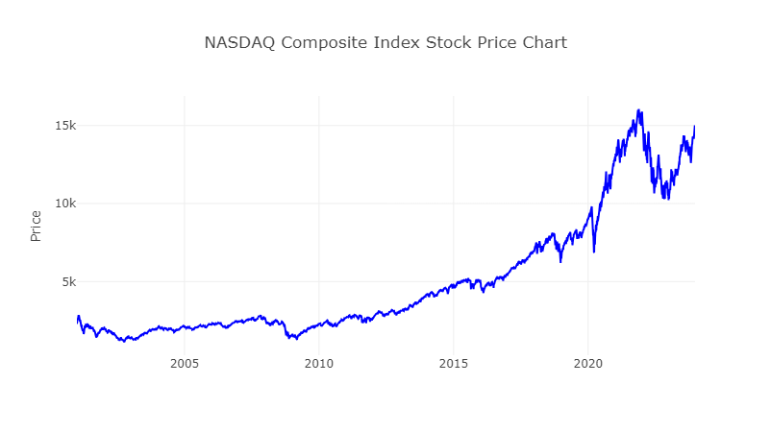

Slide 4
Comparison of Major Australian Stocks (BHP, Woolworths) since their inception

Slide 5
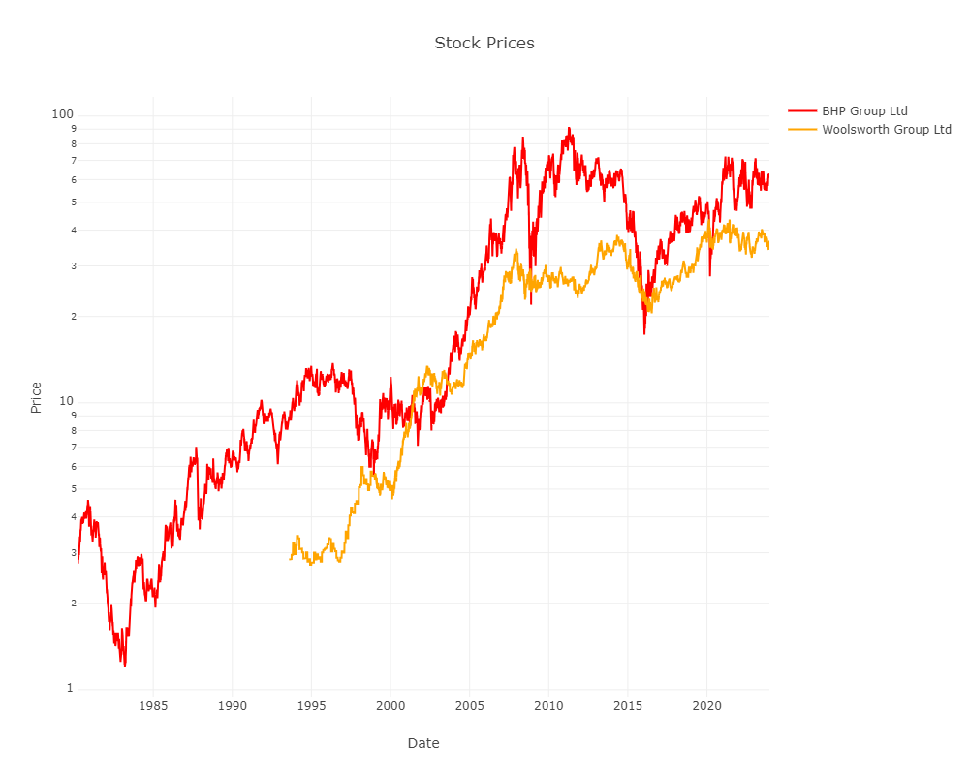

Slide 6
Limitations
Many other factors to determine stock performance
Earnings per share
Price to earnings ratio
Net margins (how efficiently a company is creating profit)

